Slide 1
“Flappy Bird”
Detailed Design and Analysis
DBC Enterprises (Group 5)
University of Notre Dame

Slide 2
Detailed Design Goals
Low weight design – stick to design drivers!
Low Drag Design
Structural Integrity
Modular component scheme for easy assembly and recovery from potential damage
Design Flexibility for any potential retrofitting

Slide 3
Wing Subassembly
Wing Loading is 0.0057 lbs/in² or 13.2 oz/ft²

Slide 4
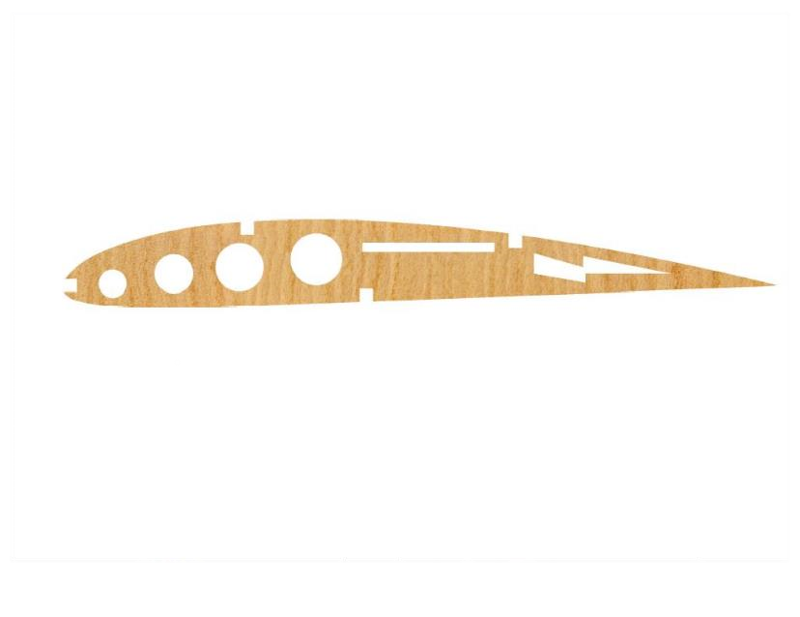
Wing Rib

Slide 5
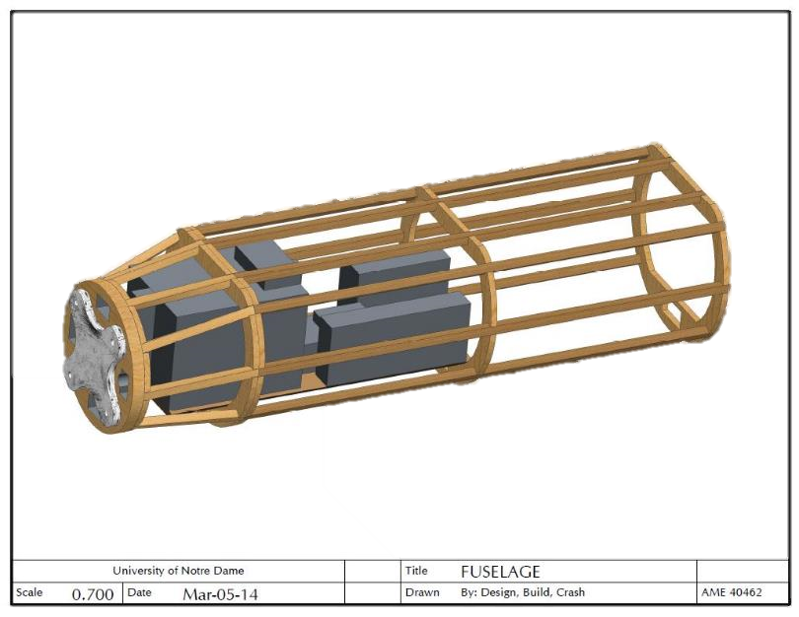
Fuselage Subassembly

Slide 6
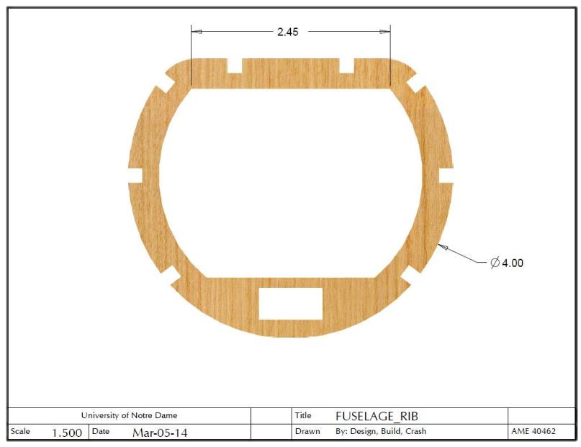
Fuselage Rib

Slide 7
Tail Subassembly

Slide 8
Structural 3-View Drawing

Slide 9
Structural Isometric View
C.G. is located slightly forward of wing ¼ chord (~2 mm).
Aircraft weighs 3.63 lbs. when fully loaded (original estimate was 3.7 lbs.)

Slide 10
Full Plane 3-View

